Slide 1
CS 425 Database Organization
Francis Leung
Fall, 2015
CS425 Spring 2015

Slide 2
Outline
Admin
Course objectives
Plan
Course Project and Exams
Forming Study Groups
CS425 Spring 2015

Slide 3
Faculty and TA
Faculty: Francis Leung
  Office: SB 226B
  Office hours: Mondays and Wednesdays: 4:30 to 5:30pm
  Email: leung@iit.edu
  Phone: extension 7-5343
TA:
  Office hours:
  Email:
TA:
  Office hours:
    Office:
    Email:
CS425 Spring 2015

Slide 4
Text Book and Prerequisites
Ullman and Widom
  A First Course in Database Systems, 3rd edition
  Pearson
  ISBN 0-13-600637.
Prerequisite:
  CS 331 or CS401 or CS403
CS425 Spring 2015

Slide 5
Course Description
The course covers fundamental database concepts including:
  Relational data modeling and design
  Abstract relational languages
  Structured query language (SQL)
  Other database concepts: concurrency control, recovery and others
CS425 Spring 2015

Slide 6
Why do we study database?
The technology is tremendously important to many practical applications
It supports a different programming paradigm; and one with a rigorous theoretical foundation
CS425 Spring 2015

Slide 7
Course Objectives
Students will be able to design a relational data model
  Analyzing a design for anomalies
  Constructing an Entity Relationship Diagram (ERD)
  Analyzing and constructing functional dependences on business rules
  Performing normalization and analyzing normal forms
  Defining referential integrities, and
  Creating database design schemas
Solve relational algebra problems
Perform database transactions using SQL
Implement a relational database application
Understand the general concepts on additional topics such as concurrency control, authorization and object relation model
CS425 Spring 2015

Slide 8
Course Syllabus (1) (Subject to change)
Week | Topic | Chapter | Due
(8/24) | Introduction, data models | 1, 2
(8/31) | Relational model and relational algebra | 2, 5.1
(9/7) | Labor day, Relational algebra, SQL | 2, 5.1, 6
(9/14) | SQL | 6, 5.2 | HW1 given
(9/21) | SQL, constraints and triggers | 6, 7
(9/28) | Constraints and triggers, Embedded SQL | 7, 9 | HW1 due, HW2 given
(10/5) | Embedded SQL | 9
(10/12) | Fall break. Dependencies and normalization | 3 | HW2 due
(10/19) | Normalization, mid term | 3
CS425 Spring 2015

Slide 9
Course Syllabus (2) (Subject to change)
Week | Topic | Chapter | Due
(10/26) | Normalization
(11/2) | Normalization, Entity relational models | 4
(11/9) | Entity relational models, midterm feedback | 4
(11/16) | Transactions, views, indexes | 6, 8
(11/23) | Authorization, Object relational model | 10
(11/30) | Object relational model | 10
(12/7) | Final Exam
CS425 Spring 2015

Slide 10
Course Requirements
Project
  A web application
Ungraded homework
  Gradiance (automated)
  http://www.newgradiance.com/services
Graded homework
Classroom quizzes
Mid term and final
CS425 Spring 2015

Slide 11
Gradiance Homework System
Automatic, fast-feedback system for taking you through standard homework problems and verifying your knowledge.
Unusual: goal is to get 100% and learn.
  Homework in FCDB is not a “mini-test.”
  You try as many times as you like and get help with each wrong answer.
Advice on using Gradiance: www.gradiance.com/info.html

Slide 12
Grading (Subject to change)
Graded Homework
  HW 1 (individual, SQL) 5%
  HW2 (individual, SQL) 5%
  HW3 (Group project design) 8%
Classroom quizzes
  Unscheduled 5%
Group Project (27%)
  Every one must participate both in the design and implementation
  Each member is evaluated individually based on his/her contribution
    Self evaluation and feature ownership
  Maximum grade one can get is based on the completeness of the project
Exams (50%)
  Mid term (20%)
  Final (30%)
Bonus credits (varies): participation, good questions and particularly insightful answers, group project proposal, others
CS425 Spring 2015

Slide 13
Policies
Late assignments: Late assignments will not be accepted without prior notification and approval (see next viewgraph on additional rules).
Make-up exams: Make-up exams must be arranged in advance and follow the rules of the department. If you miss an exam without notifying me, you will receive 0 points.
All work must be original. Any student found cheating will receive a 0 for the assignment or exam. Depending on the situation, the student may receive an E for the course. No exception will be made.
All students must contribute to all phases of the project. Students that do not contribute to any of the projects will have their final grade dropped by one letter grade. Student contribution will be based on the peer evaluation forms, completed by each team, submitted with each project.
CS425 Spring 2015

Slide 14
CS425 Late submission policy
Submitting a project that does not compile nor run and then later submitting one that does is considered the same as not submitting on time.
Unless otherwise approved, the late penalty is 20% per day. The project will not be accepted if it is submitted more than 5 days late.
CS425 Spring 2015

Slide 15
Forming a project team
A team is composed of 3 classmates. Occasionally, it can be 2.
Forming a team is your responsibility. Your professor and TA will help you when requested.
A forum in Blackboard will be open. You can use it to find team members
Team membership is due on TBA. If you are not in a team after that, you will be assigned to a team.
CS425 Spring 2015

Slide 16
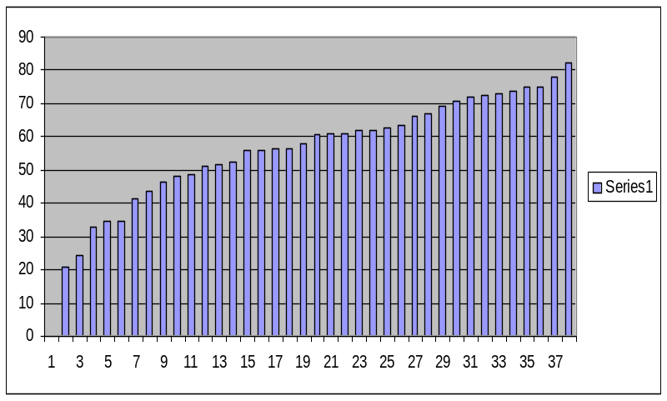
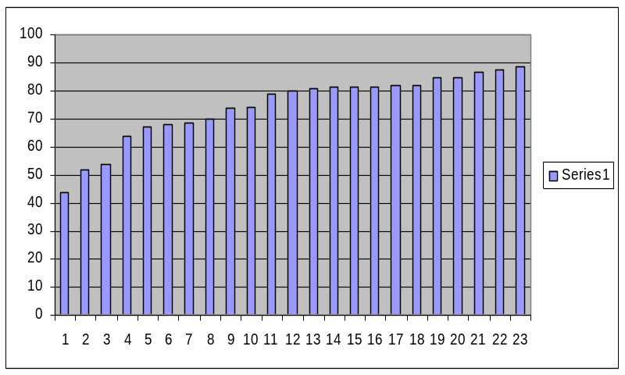
Effect of attendance (CS487)
Spring 2008, average = 57.3
Fall 2008, average = 74.7
CS425 Spring 2015

